Slide 1

Draft Fiscal Year 2024
Work Program, Budget, and Dues
May 26, 2023

Slide 2
Presentation Outline
1. Budget Background
2. Analysis of WCCTAC General Operations
- Current Year (FY23) Budget
- Upcoming Year (FY24) Budget
3. Proposed Dues for FY24
4. Other Budgets: STMP
5. Accomplishments for FY23
6. Proposed Work Program for FY24

Slide 3
Background: Revenues for Administration

Slide 4
Background: Revenues in Operations Budget

Slide 5
Background: Revenues in TDM Budget
TFCA Program Funds

Slide 6
Background: Revenues in STMP Budget
STMP Program Funds

Slide 7
Background: Expenses for Administration

Slide 8
FY 23 Budget vs Year End Estimates
$20K
Expenses
Revenues
$4K
3.5%
COLA
$2K
Merit
Pay
$0K
$-2.4K
-$6K
Legal Expenses
PERS
UAL
Measure J 20b/21b
Caltrans Grant
(staff time)
Salary & Benefits (excluding TT Program)
Benefits
Prof. Services
Training / Mileage
Benefits
Misc.
Contingency

Slide 9
Proposed COLA for FY24 Budget
 | FY 21 | FY 22 | FY 23 | FY 24
CCTA COLA | 2.5% | 2.0% | 3.5% | 3.5%
WCCTAC COLA | 0.0% | 3.5% | 3.5% | 3.5% (proposed)

Slide 10
Changes in FY24 Operations Budget
$35K
$28.5K
$22K
Expenses
Revenues
3.5%
COLA
Merit
Pay
$3K
PERS
UAL
Benefits
Prof. Services
$1.5K
$-1.5K
Legal Expenses
Benefits
Misc.
Caltrans Grant
(staff time)
Salary & Benefits (excluding TT Program)
Financial Services
Dues
Training / Mileage

Slide 11
General Operations Budget - Balance
Audit Info
Balance
Reserve Policy
$140K

Slide 12
Proposed Dues for FY24
Fiscal Year | FY 21 | FY 22 | FY23 | FY 24
Feb CPI | 2.9% | 1.6% | 5.2% | 5.3%
Dues Increase for Upcoming FY | 0% | 1.5% | 4.5% | 5.0%* (proposed)
* Does not include Board Member Stipends
6% if $50 per meeting
7% if $100 per meeting

Slide 13
FY24 STMP Budget

Slide 14
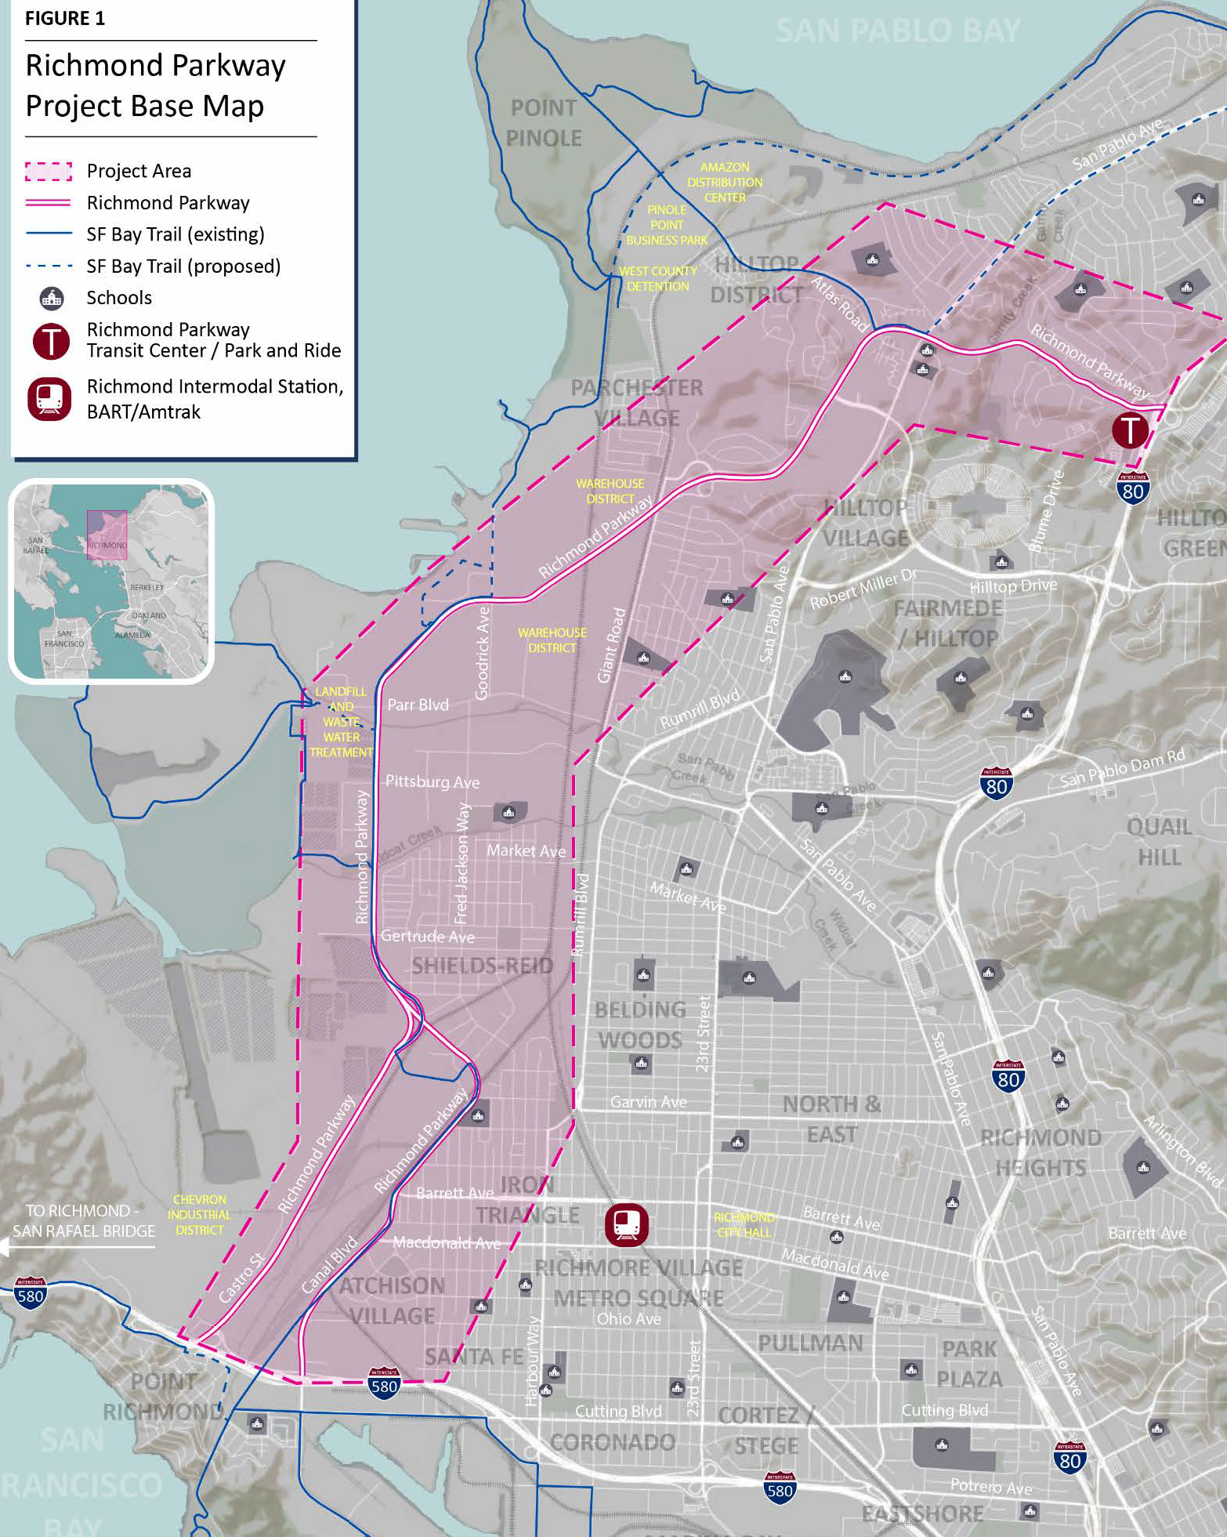
FY 23 Accomplishment Highlights
Completed San Pablo Avenue Multimodal Corridor Study – Phase 2 in partnership with the Alameda County Transportation Commission (ACTC) to investigate complete street elements.
Launched the Richmond Parkway Transportation Plan (RPTP) effort based on a $635,000 Caltrans Sustainable Transportation Planning grant
Notes:
13 for TLC + Safe Routes, 17 overall. About $27M

Slide 15
FY 23 Accomplishment Highlights
Participated in the I-80 Design Alternatives Assessment led by MTC, with ACTC and CCTA. Previous WCCTAC studies helped shape outcomes
Completed the Draft West County Action Plan for Routes of Regional Significance, which includes goals and actions for improving mobility.
Notes:
13 for TLC + Safe Routes, 17 overall. About $27M

Slide 16

FY 23 Accomplishment Highlights
Created a new TDM program, Take 10, which provides 10 free trips on long distance bus routes for AC Transit, WestCAT and SolTrans.
Had the largest year ever for the Pass2Class Program, with over 1,500 participants, which slightly exceeded pre-pandemic levels. The program offers free bus passes to students at the beginning of the year.
Notes:
13 for TLC + Safe Routes, 17 overall. About $27M

Slide 17
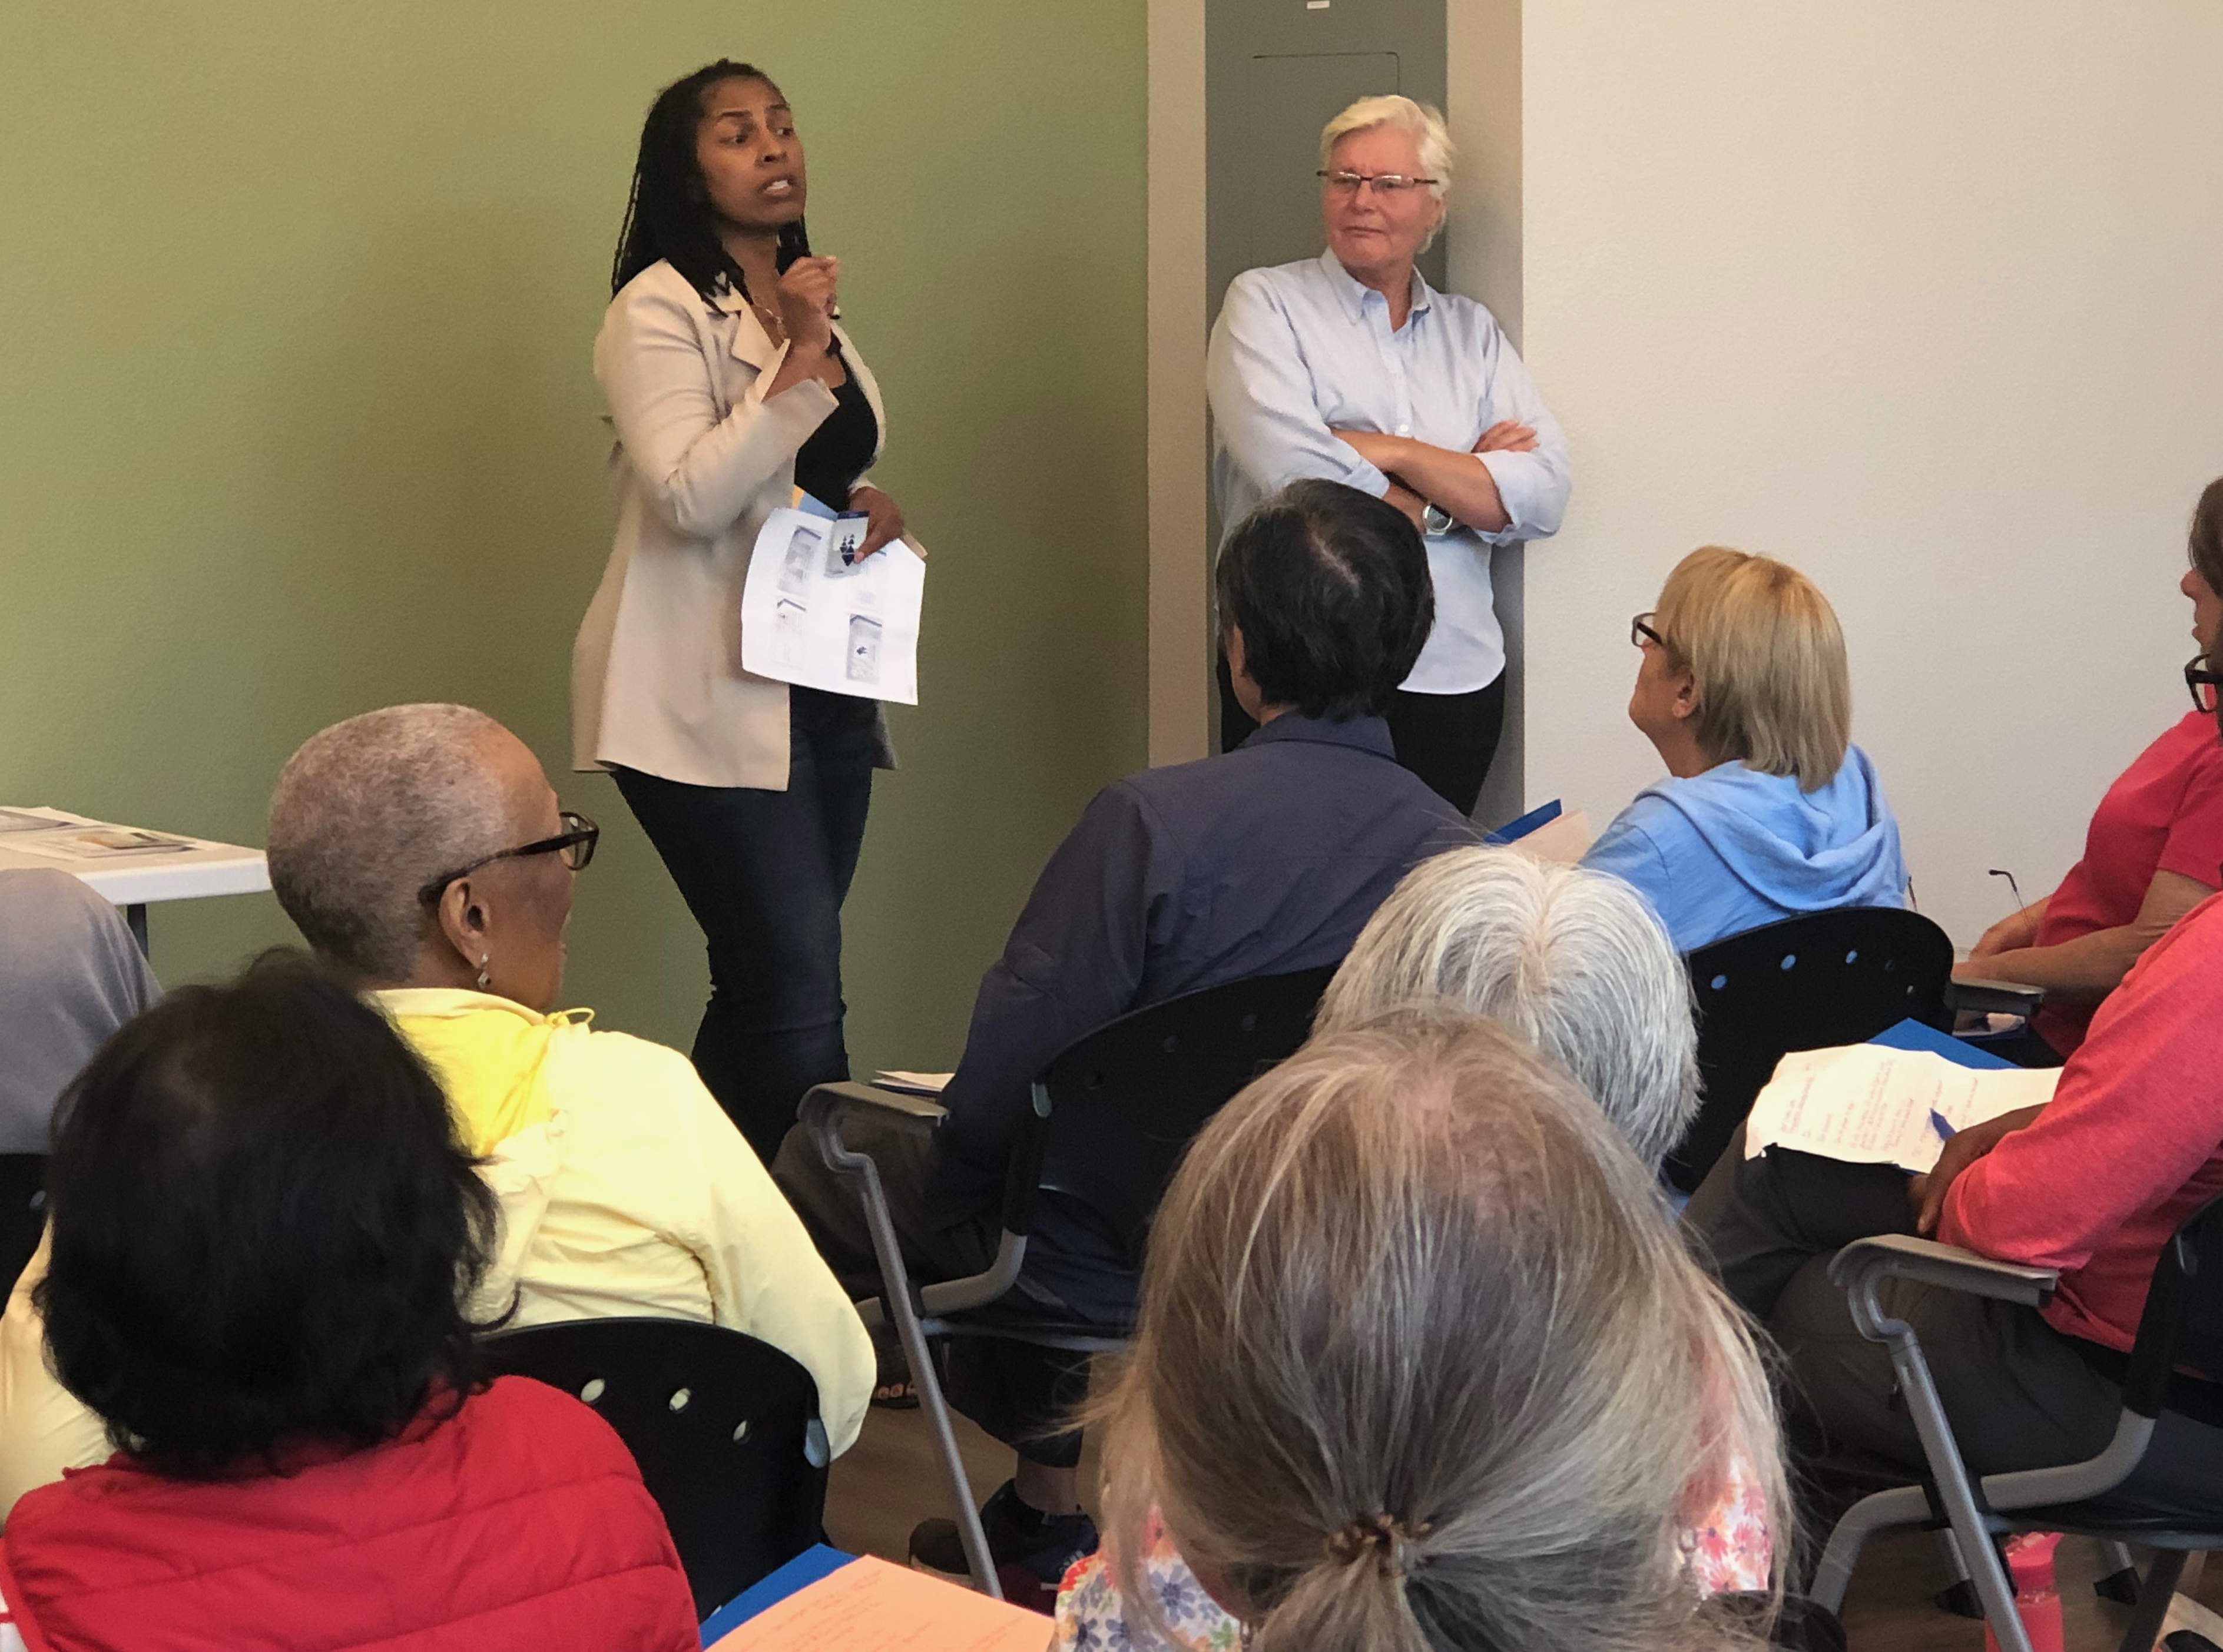
FY 23 Accomplishment Highlights
Released a Call for Projects for $5.3M in STMP funding for projects in West County.
Revived the Travel Training Program which trains West County seniors on how to use local public transit and other services.
Notes:
13 for TLC + Safe Routes, 17 overall. About $27M

Slide 18
FY 24 Work Program – Ten Highlights
  1) Joint Powers Agreement (JPA) Update
  2) Richmond Parkway Transportation Plan (RPTP)
  3) Follow-up to San Pablo Ave Multimodal Corridor Study
  4) Countywide Plan Update with CCTA
  5) Training sessions for member agency staff on GMP checklist
Notes:
13 for TLC + Safe Routes, 17 overall. About $27M

Slide 19
FY 24 Work Program – Ten Highlights
  6) Allocation of $5.3M in STMP funds to West County projects
  7) Preparation for next STMP Update
  8) Medical Trip Pilot Program for Seniors / Disabled
  9) Re-launched Travel Training Program
  10) Evaluate Work Practices and Office Lease
Notes:
13 for TLC + Safe Routes, 17 overall. About $27M

Slide 20
Recommended Board Action
Authorization to circulate the Draft Fiscal Year 2024 Work Program, Budget, and Dues documents to member agencies.
Notes:
13 for TLC + Safe Routes, 17 overall. About $27M

Slide 21
HDFD
Questions ?
May 26, 2023

