Slide 1

Draft Fiscal Year 23
Work Program, Budget, and Dues
May 27, 2022

Slide 2
Presentation Outline
1. Analysis of WCCTAC General Operations
- FY22 Budget vs Forecasted Actuals
- FY22 Budget vs Draft FY23 Budget
2. Proposed Dues for FY23
3. Draft TDM and STMP FY23 Budgets
4. Accomplishments for FY22
5. Proposed Work Program for FY23

Slide 3
General Operations Budget - Balance
$79,858
above
$58,806
above
$26,307
above
Balance
Reserve Policy
$140K
2017
2018
2019
2020
2021
2022

Slide 4
General Operations Budget - Balance
$79,858
above
$58,806
above
$43,713
above
Balance
Reserve Policy
$140K
2017
2018
2019
2020
2021
2022

Slide 5
FY22 Budget vs Forecasted Actuals
Prof. Services
(mostly IT)
Training
& Mileage/ Transit
Office Expenses
Salaries & Benefits
Contingency

Slide 6
Proposed COLA for FY23 Budget
 | FY 21 | FY 22 | FY 23
CCTA COLA | 2.5% | 2.0% | 3.5%
WCCTAC COLA | 0.0% | 3.5% | 3.5% (proposed)

Slide 7
FY22 Budget vs Draft FY23 Budget
$16K
3.5%
COLA
Merit
Pay
$4K
PERS
UAL
Benefits
Prof. Services
Benefits
Misc.
-$1.5K

Slide 8
FY22 Budget vs Draft FY23 Budget
$24.5K
$16K
$15K
Dues
$10K
3.5%
COLA
Measure J 28b Travel Training
Merit
Pay
$4K
STMP Admin.
PERS
UAL
Benefits
Prof. Services
Benefits
Misc.
-$1.5K

Slide 9
Proposed Dues for FY23
Fiscal Year | FY 21 | FY 22 | FY 23 proposed
Feb CPI | 2.9% | 1.6% | 5.2%
Dues Increase for Upcoming FY | 0% | 1.5% | 4.5%
Amount for Regular Member | $48,930 | $49,664 | $51,899

Slide 10
TDM Revenue: FY22 vs FY23
TFCA

Slide 11
TDM Revenue: FY22 vs FY23
Retained by CCTA
$252K
TFCA
Reallocation
TFCA
TFCA
Measure J

Slide 12
FY23 STMP Budget
$7,757,319
$807K Available
$3.75M
2019 Program
Commitments
$3.2M
2006 Program Commitments

Slide 13
FY23 STMP Budget
$8,349,375
$7,757,319
Spent $65K
$775K New Revenue
$807K Available
$742K Available
$3.75M
2019 Program
Commitments
$3.2M
2006 Program Commitments
$3.07M
2006 Program Commitments
Spent
$123K

Slide 14
FY23 STMP Budget
$8,349,375
$7,757,319
$775K New Revenue
Spend $75K
$807K Available
$742K Available
$5,231,840
$3.75M
2019 Program
Commitments
Spend all
$3.79M New Revenue
$3.2M
2006 Program Commitments
$3.07M
2006 Program Commitments
Spend all
$1.44M Available

Slide 15
FY 22 Accomplishment Highlights
Began updating the West County Action Plan for Routes of Regional Significance, which includes goals and actions for improving mobility.
Nearly completed San Pablo Avenue Multimodal Corridor Study – Phase 2 in partnership with the Alameda County Transportation Commission (ACTC) to investigate complete street elements.
Notes:
13 for TLC + Safe Routes, 17 overall. About $27M

Slide 16
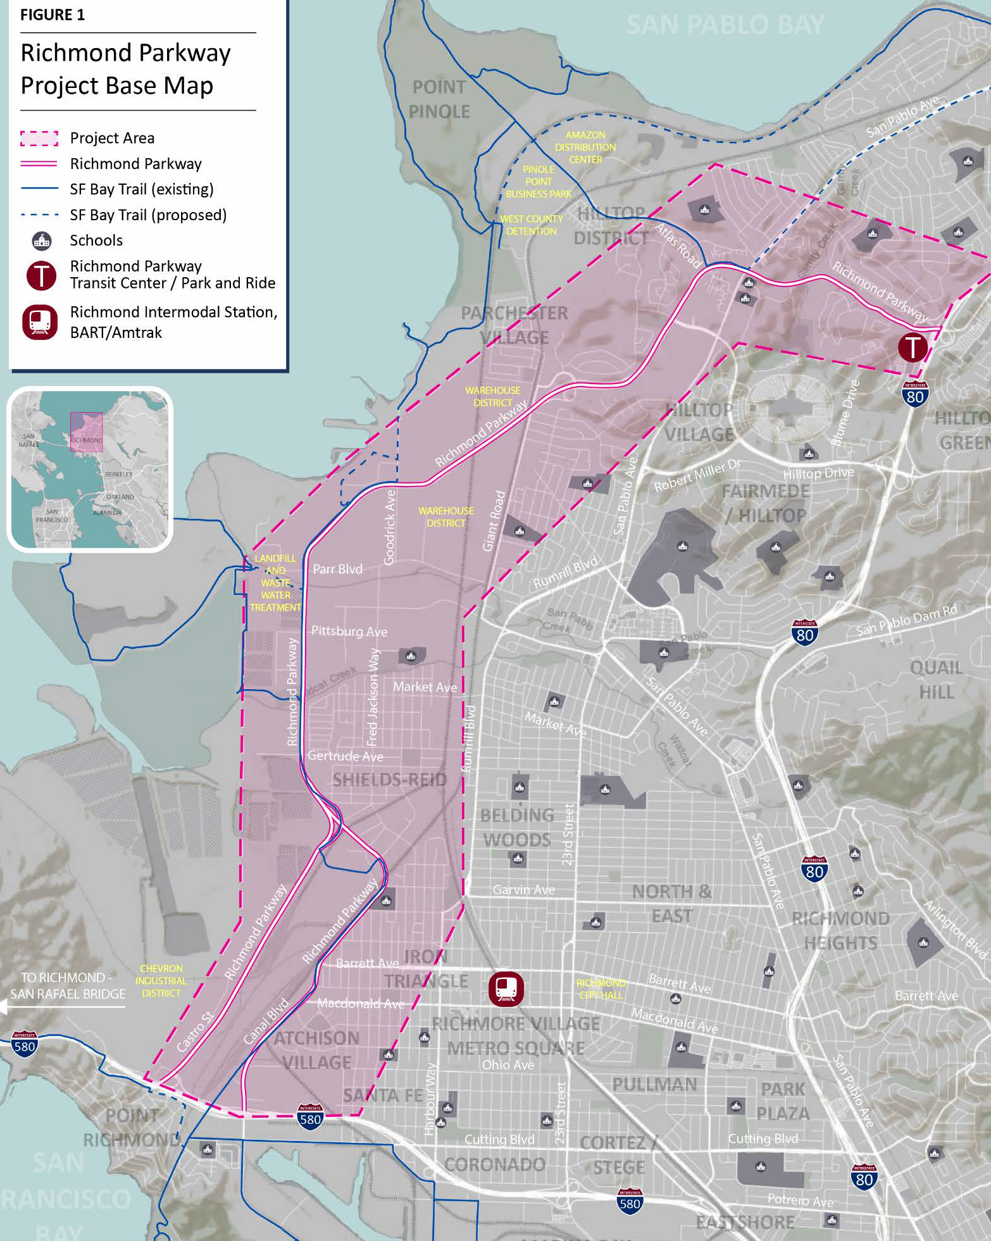
FY 22 Accomplishment Highlights
Joined with other agencies to participating in the I-80 Design Alternatives Assessment led by MTC, ACTC and CCTA.
Competed successfully for a $635,000 Caltrans Sustainable Transportation Planning grant to conduct a Richmond Parkway Environmental Justice and Regional Mobility Study.
Notes:
13 for TLC + Safe Routes, 17 overall. About $27M

Slide 17

FY 22 Accomplishment Highlights
Revived the Pass2Class program, which offers free bus passes to students at the beginning of the year; approached pre-pandemic levels, with over 1,200 students participating
Started a new program, the Summer Bike Challenge, which encourages families to bicycle to various locations around their community.
Notes:
13 for TLC + Safe Routes, 17 overall. About $27M

Slide 18
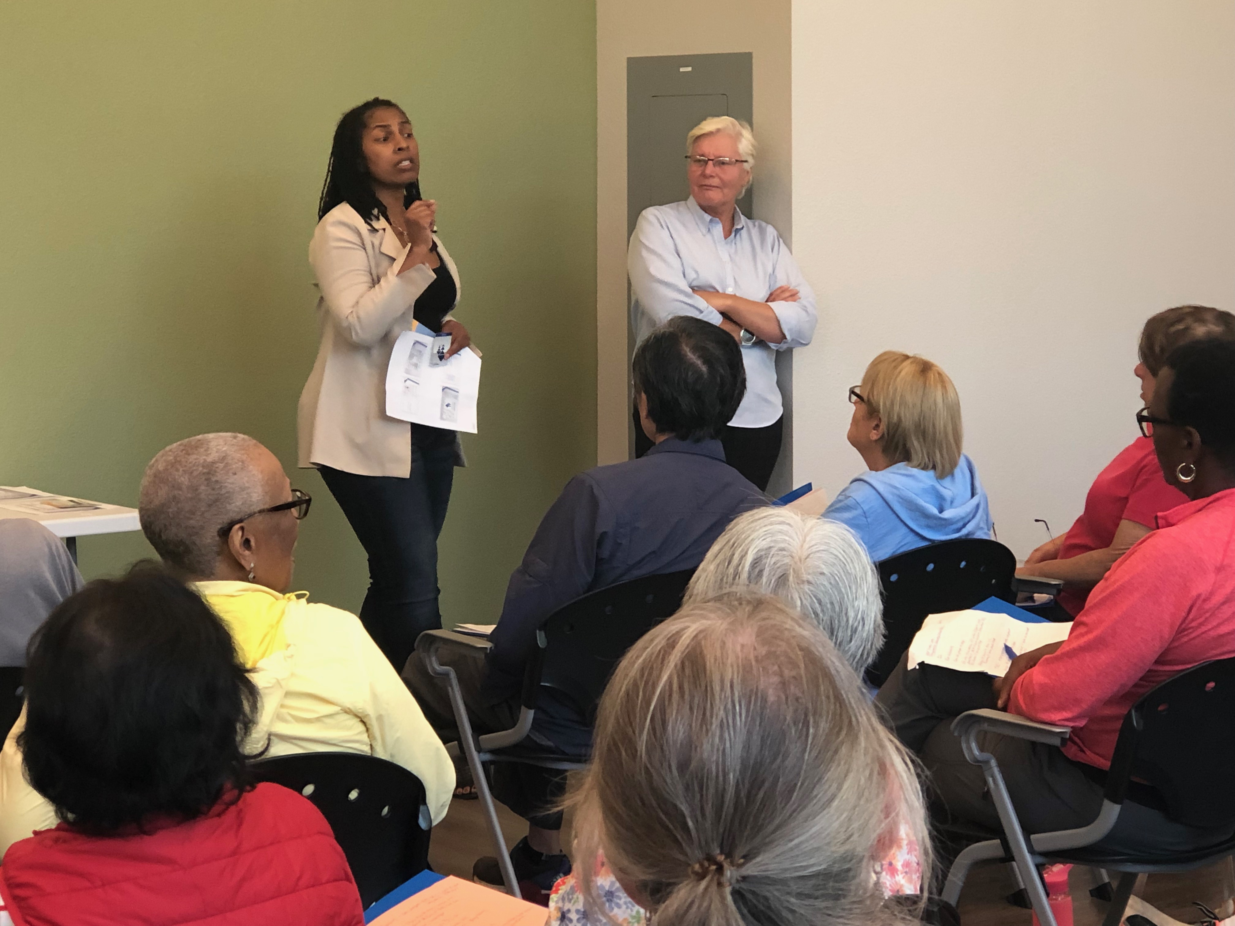
FY 22 Accomplishment Highlights
Revived the Travel Training Program which trains West County seniors on how to use local public transit and other transportation services.
Notes:
13 for TLC + Safe Routes, 17 overall. About $27M

Slide 19
FY 23 Work Program - Highlights
  Will Complete
  Phase 2 of the San Pablo Avenue Corridor Study
  West County Action Plan
Notes:
13 for TLC + Safe Routes, 17 overall. About $27M

Slide 20
FY 23 Work Program - Highlights
  Will Continue
  I-80 Design Alternatives Assessment (DAA) TAC
  Re-launched Travel Training Program
  Accessible Transportation Strategic Plan and Task Force activities
  I-580 ORT/HOV project development discussions
  Evaluating Work Practices
Notes:
13 for TLC + Safe Routes, 17 overall. About $27M

Slide 21
FY 23 Work Program - Highlights
  Will Begin
  TDM Use of TFCA funds for small capital improvement/s
  Launch Richmond Parkway Study
  Countywide Plan
  Training sessions for member agency staff on Growth Management Program checklist compliance
Notes:
13 for TLC + Safe Routes, 17 overall. About $27M

Slide 22
HDFD
Questions ?
May 27, 2022

